Slide 1

GAMES RESEARCH & DEVELOPMENT
“This module provides a platform for students to immerse themselves in this rapidly moving stream of innovation, deploying new technologies across a range of contexts and emerging application areas; forming the basis of a valuable portfolio that provides an entry point not only to research and development within the Games industry itself, but also to cutting-edge academic research and real-world application.”
World One Powerful Presentation Template
Notes:
Background placeholder: After choosing your image, Right click on the image -> Send to back -> Click on send to back

Slide 2
THIS
SESSION
Internal Conference
Longer Proposal
Research Required
Testing
Ethics

Slide 4
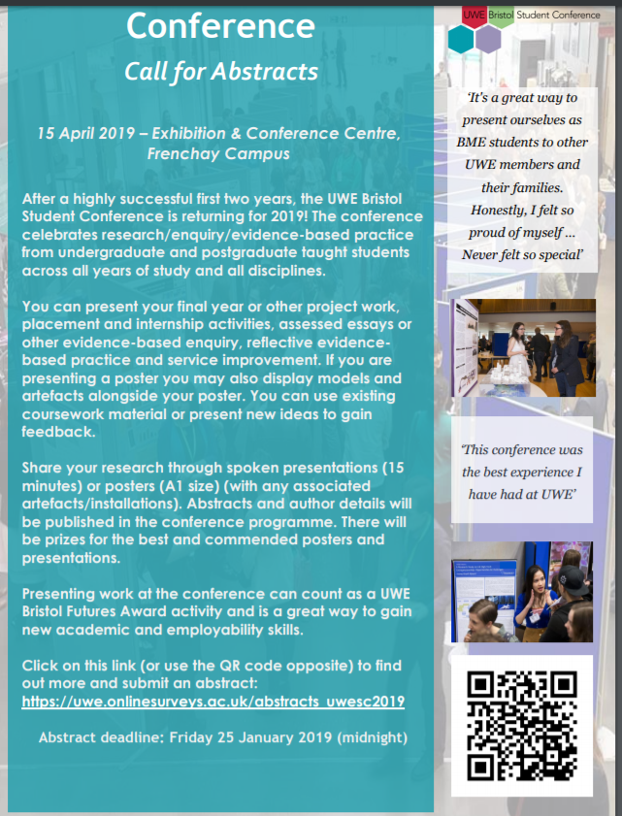

Slide 5
E-mail to out Clients (soon to go out)
Many Thanks Once again for your Client Briefs for GRD,
So I thought I’d give you a rundown of my plans for going forward.
I’ve presented them to the students during their session on a couple of weeks, so could give them some time to think them over.
Nov 13th: We had a session for discussion and brainstorming about all of the briefs, in part to come up with a select few starting questions for you the clients. (Thanks to those of you who responded so quickly)
Nov 20th : (This Week) I asked them to submit two short (1-2 page) preliminary proposals for the their top two projects they’d like to tackle.
Nov 27th: I’ll “official” assign projects to students and (if okay by you) give them your e-mails to contact for your input.
I’ll shall ask the students to obviously keep you posted as to their progress, but as I’ve said previously, how much input you wish to have is totally up to you, so if you feel the student is taking up too much of your time please do not hesitate to contact me to ask them to “dial it down”.
Also, in the end I had 8 projects for 7 students, so if I get no takers for any of the projects, my apologies, but would ask if you’d be okay to be put into the pull for next year?
By the 4th December they’ll have a fuller proposal documents containing Milestones and goals constructed in consultation with yourselves, and potential a VERY VERY early stage prototype.
Once again many thanks to all of you for being our “clients” and suggesting a brief, and here’s to a hopefully successful collaboration.
All the best
SIMON

Slide 6

Longer Proposal
As first stage proposal not marked in itself but will form part of your development documentation etc.
You’ll find a consultancy template next to these slides on Blackboard.
Don’t actually use this document, but possibly use similar sections and complete in a similar spirit.
World One Powerful Presentation Template
Notes:
Background placeholder: After choosing your image, Right click on the image -> Send to back -> Click on send to back

Slide 7
Research Required
Let’s do some “research exercises”
World One Powerful Presentation Template
Notes:
Background placeholder: After choosing your image, Right click on the image -> Send to back -> Click on send to back

Slide 8


This
Task
I’ve said this before…
For implementation okay tutorials, web-sites, YouTube videos will be fine to find the right direction…
Even Wikipedia (good for keywords and connections )
BUT NOT FOR THE WRITE UP!
Let’s try these few terms from graphics / games
Find an kind to implementation AND the original reference
Boids
Perlin Noise
Lambert
Blinn
Phong
A*
Notes:
Progress Log
Components, rationale
Tutor logging
Average percentage mark

Slide 9
A way to read
CEM Joad wrote Teach Yourself Philosophy in 1944. His advice can be applied to reading scientific papers. He says:
Make judicious selection. In philosophy Joad says "Never try to read a whole book at once." In our case, do not try to read all the papers on a subject at once. Joad says "pick out certain chapters, two or three perhaps, which deal with matters that seem to you to be of particular importance or which relate to topics on which you have already read something." We need to pick out those papers that are of most importance to the problem in hand. Of philosophy books, Joad says "Use the introduction and preface to help you identify these." In our case, we need to use something else to determine which papers we should attend to. See Fred Brooks' note (above) for more on that.
Indulge in intelligent skipping. You do not have to read everything. You do not need to read every word of every paper. Do not be embarrassed to skip. You cannot possibly read every paper in the world; you need to ensure that the ones you spend your time on are the important ones. For some papers you need only look at the introduction and conclusion, with a glance elsewhere. For some, you will need to read the whole thing, but maybe not today. Joad says "omit the unintelligible; skip the repetitions; jump over the boring bits". You are allowed to do this!
Ensure you understand. Joad says stop reading when you stop understanding, but he also says to interpret "understand" generously. If you do not understand, there is sometimes point in pressing on a little further to see if it becomes clear, but if you really do not get it, there is no point in reading on for the sake of reading on. You need to stop and say "why do I not understand?"; "is this important enough that I need to learn something else so that I can understand?"
Make notes. The process of writing notes helps enormously with remembering. The process of having to summarise someone else's work helps enormously with understanding. Exercise 1 asks you to precis the content of an eight page paper in just one page. This is a great skill to have. Also you need to ensure that you have made good enough notes that you will be able to find any paper again in two years time when it turns out to be important. Too many times have I heard the cry "I know that I have read a paper on exactly this problem, but I cannot remember where!"
https://www.cl.cam.ac.uk/teaching/0910/C00/L1/

Slide 10
The nature of papers
The starting research student assumes that all research papers are well-written and describe good research that is both correct and important. This is not true.
Research papers can report poor research. The review process is supposed to prevent this, but it is not a perfect process and there is a fair amount of published work out there that is not good. The publication venue is a guide to likely quality. A top-rank journal or conference is unlikely to publish poor research, because the review process is fierce. A lower-rank journal or conference is more likely to let poor research through.
Published research is supposed to be correct. However, there are cases where the authors and reviewers have honestly failed to notice that their data, assumptions, proofs, or conclusions are wrong.
A big mistake made by many new researchers is to think that every single paper is important. Of course, it was important to the authors, but it may well be reporting on a dead end, a trivial result, a system that does not work well, or an idea that has been superseded. So you will find that many papers are unimportant, at least with respect to your particular research area.
Even if a paper is good research, correct, and important, it may not be well written. Sadly, there are some papers that are incomprehensible. It is wrong to assume that the authors are trying to hide something in their poor writing, though this may be the case. Often it is just poor writing skills. Part of this course is to help you to learn how to ensure that your papers are well written.
https://www.cl.cam.ac.uk/teaching/0910/C00/L1/

Slide 11
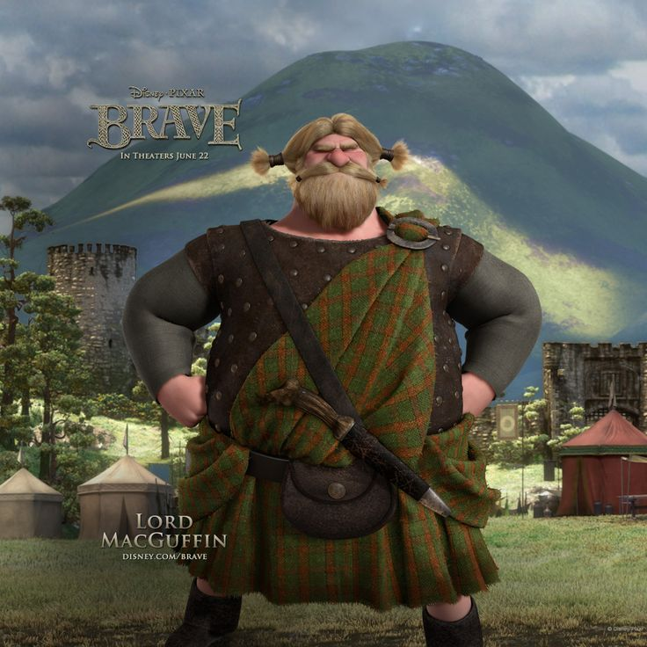
Missing MacGuffin
In movies and fiction?
Often, although not always deliberately that last critical feature on how you actually implement the damn thing is missing from a research paper
Why?
Industry presentations and papers can be just as bad.
Often the technique they are willing to talk about but the actual implementation will be under NDA

Slide 12
Secondary Research
What other folks have done!
World One Powerful Presentation Template
Notes:
Background placeholder: After choosing your image, Right click on the image -> Send to back -> Click on send to back

Slide 13
Primary Research
What you do!
World One Powerful Presentation Template
Notes:
Background placeholder: After choosing your image, Right click on the image -> Send to back -> Click on send to back

Slide 14
Testing
DO SOME!
World One Powerful Presentation Template
Notes:
Background placeholder: After choosing your image, Right click on the image -> Send to back -> Click on send to back

Slide 15
This
Task
Let’s choose one of the last year briefs…
What might we actually produce for it…
How could me confirm that it “works” with user testing
3rd person navigation in VR using PSVR
Can we come up with a testing procedure for this?
Suppose we had a set of ways for doing this.
What sort of tests would we use to compare them and how?
Notes:
Progress Log
Components, rationale
Tutor logging
Average percentage mark

Slide 16
Dry
World One Powerful Presentation Template
Notes:
Background placeholder: After choosing your image, Right click on the image -> Send to back -> Click on send to back

Slide 17

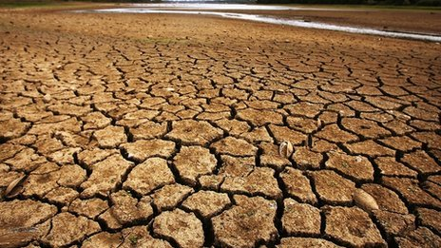
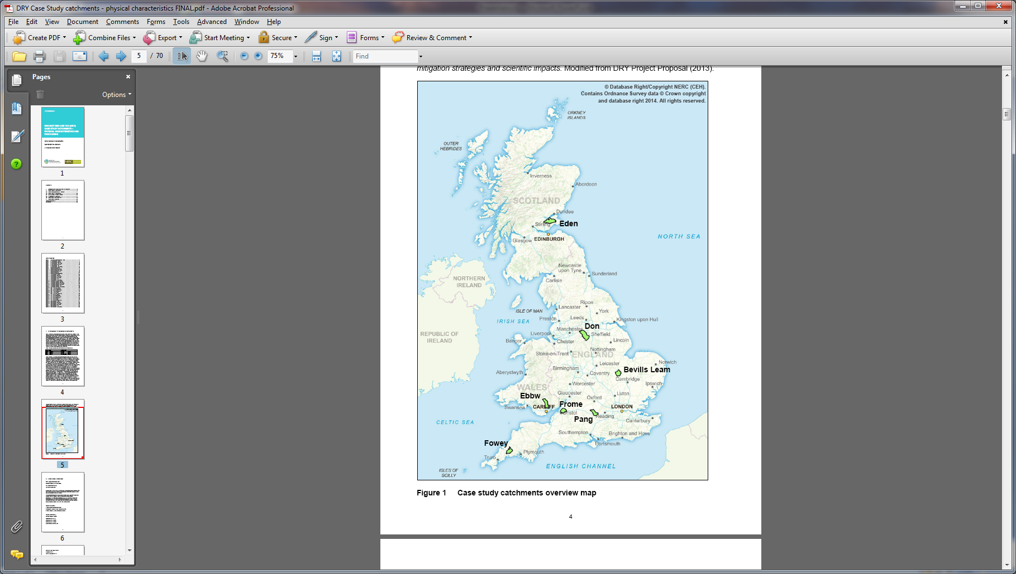
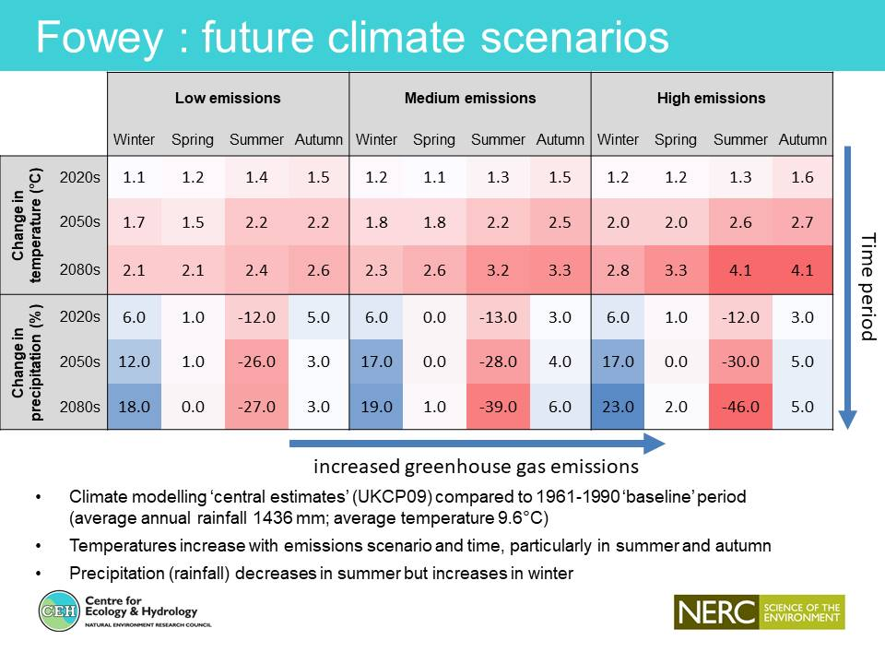
DRY – SUPPORTING DROUGHT RISK DECISION-MAKING
To integrate narrative (storied) methods/resources and drought science to assist multi-stakeholder decision-making for UK drought mitigation and management
Evaluating alternative management strategies for mitigation of water shortages under present and future climate.
Stripping back ‘uncertainty’ to give some sense of different futures and the scale of possible changes
DRY is working in seven case-study catchments across the UK

Slide 18
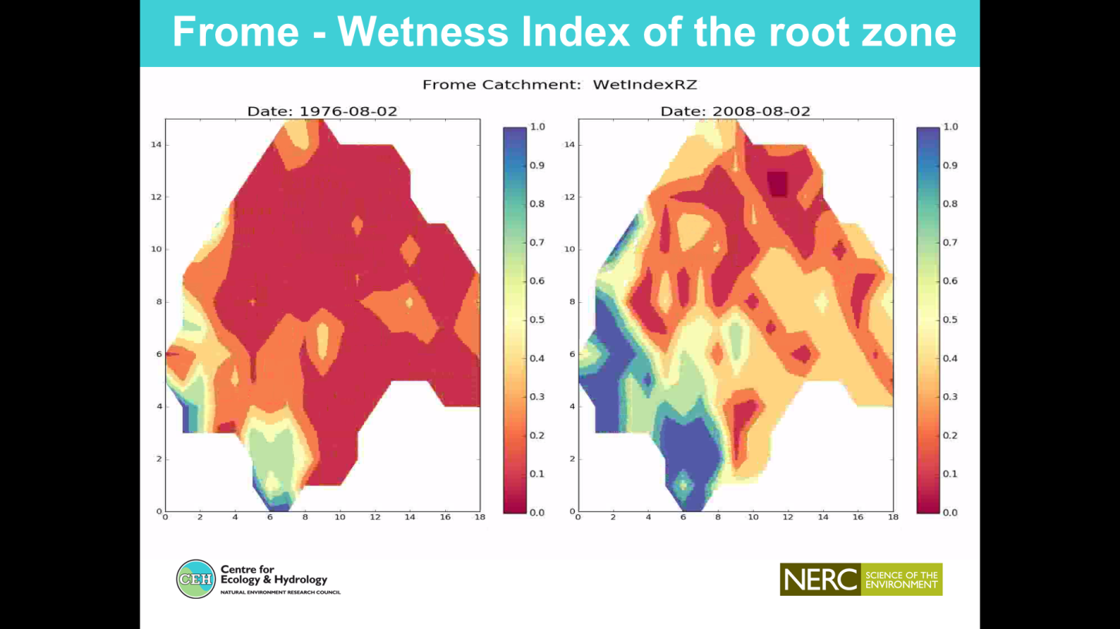
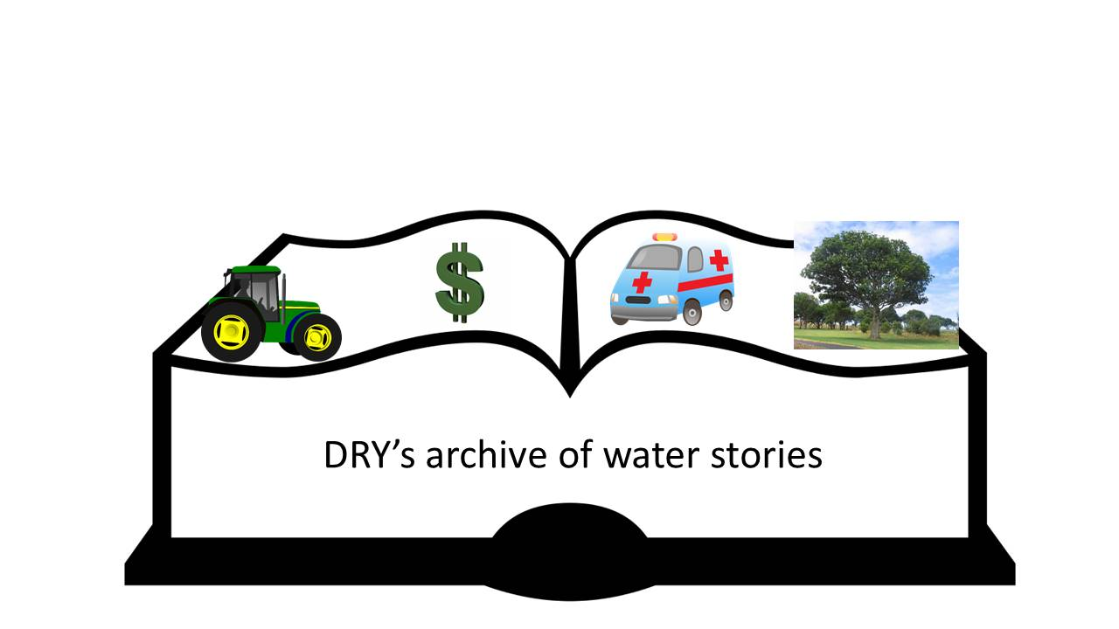
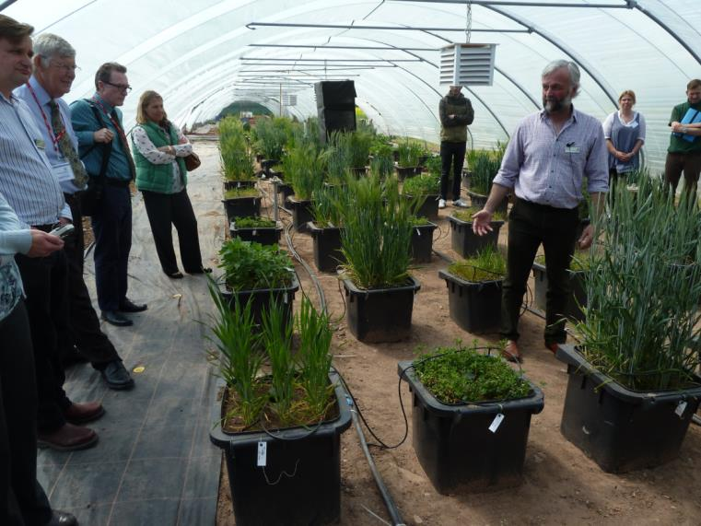
How do we engage people through stories?
Same crops or different crops and change of diet?
DRY has been experimenting with animations to help with ‘scenario-ing’ future droughts
Animating drought - quinoa v potato
Your task:
To work with the DRY project team to explore how the science of future drought scenarios (e.g. graphs and animations) could be brought together with an archive of narratives (digital stories; micro-narratives; films) as a stimuli for provoking different thinking about drought and water scarcity in one of DRY’s study catchments – like the Bristol Frome. The work could be positioned in different ways (e.g. on agriculture)
To showcase your ideas with an audience of professional stakeholders.
‘The UK is thought of as a wet county; the last major drought was in 1975/76 and so is out of living memory for most people. How do we get people thinking about possible futures where we may have underlying drought but also floods? How do we get people to think about how they might adapt.? People are ‘the public, communities, businesses, farmers, urban designers, those concerned with public health’

Slide 19
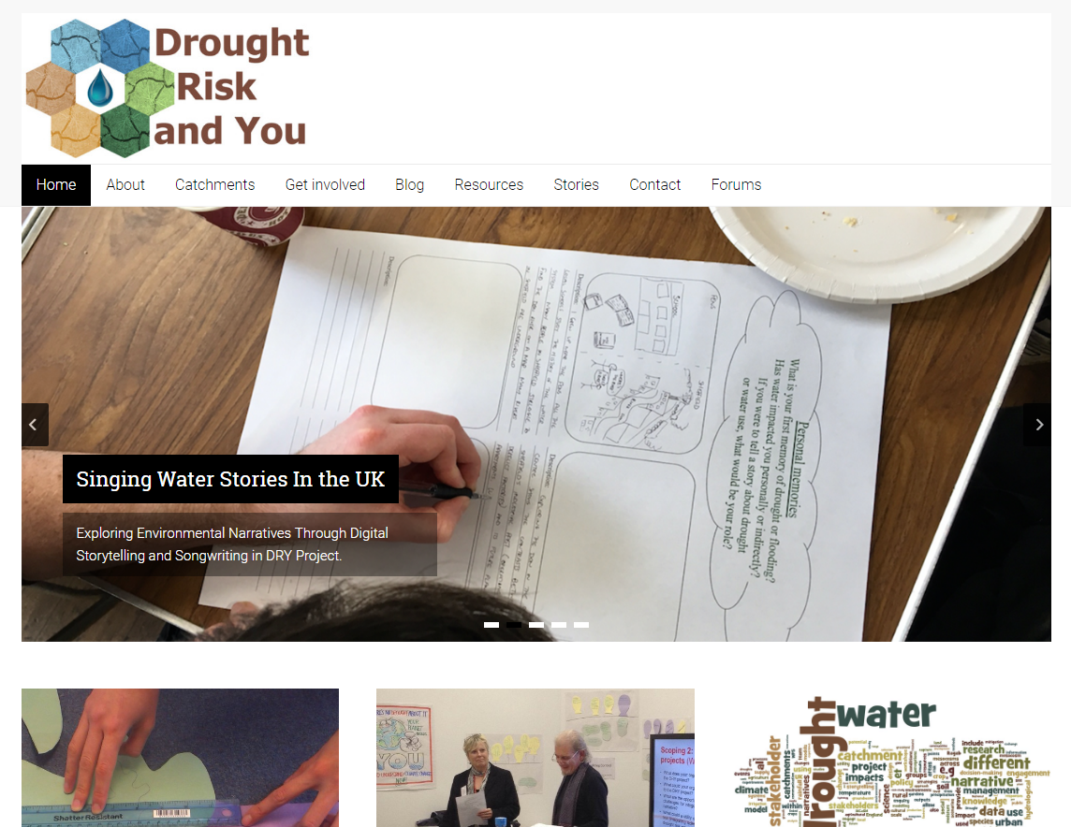





Interdisciplinary team – spanning hydrology, ecology and agronomy to media, memory and drama.
Variety of resources: e.g.
Animating drought - quinoa v potato
www.dryproject.co.uk
@Project_DRY

Slide 20
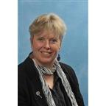
This
Task
Client…
Prof Lindsey McEwen
Professor in Environmental Management
Things He’d Like…
Not really sure how they can use Games or games related stuff, so contacting them to try and ascertain that would probably be useful.
Notes:
Progress Log
Components, rationale
Tutor logging
Average percentage mark

Slide 21
Sustainable
World One Powerful Presentation Template
Notes:
Background placeholder: After choosing your image, Right click on the image -> Send to back -> Click on send to back

Slide 22
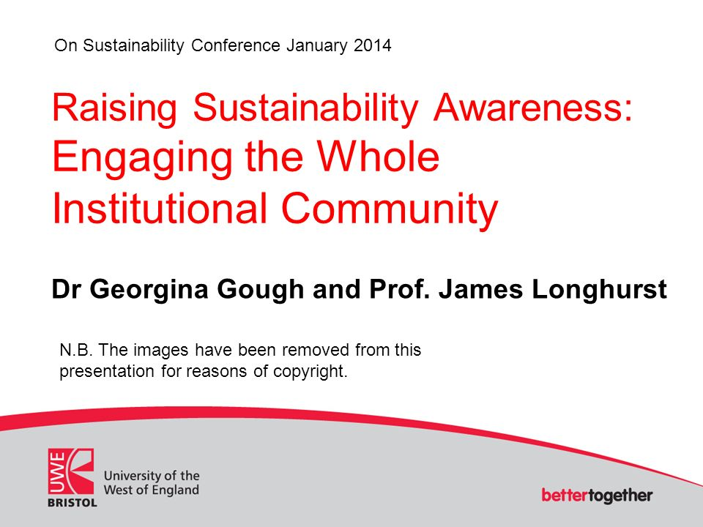
Sustainable Development
Your task:
Investigate the potential for games, AR or VR to be used to engage students in learning for sustainable development.
Sustainable Development Goals must be used as the framework for sustainable development.
Context for use could be classroom or for self-directed learning.
Application for use for secondary school outreach activity would be a bonus.
Your task:
How could games, AR or VR be best used to explore links between professional practice of an academic and sustainable development.
Sustainable Development Goals must be used as the framework for sustainable development.
Objective is to promote individual responsibility for demonstrating positive behaviours and for contributing to the development of sustainably-literate and responsible graduates.
Relevance to all staff (and possibly even students) within a higher education setting is desirable.
Your task:
How can academics use games, AR or VR to demonstrate applicability of sustainable development to relevant professional practice?
Sustainable Development Goals must be used as the framework for sustainable development.
Development of a platform which could readily be adapted to various professions would be ideal.
Application for use in CPD (continuing professional development) activity for professionals is also important.
Notes:
Wireframe shader

Slide 23
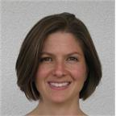
This
Task
Client…
Dr Georgina Gough
Senior Lecturer in Education for Sustainable Development
Things They’d Like…
Not really sure, and wants to be given suggestions and be involved in the discussion, the three versions of the task shown are quite similar, could some form of framework be done for one and show how it might be altered for all three?
Notes:
Progress Log
Components, rationale
Tutor logging
Average percentage mark

Slide 24
Drone
World One Powerful Presentation Template
Notes:
Background placeholder: After choosing your image, Right click on the image -> Send to back -> Click on send to back

Slide 25
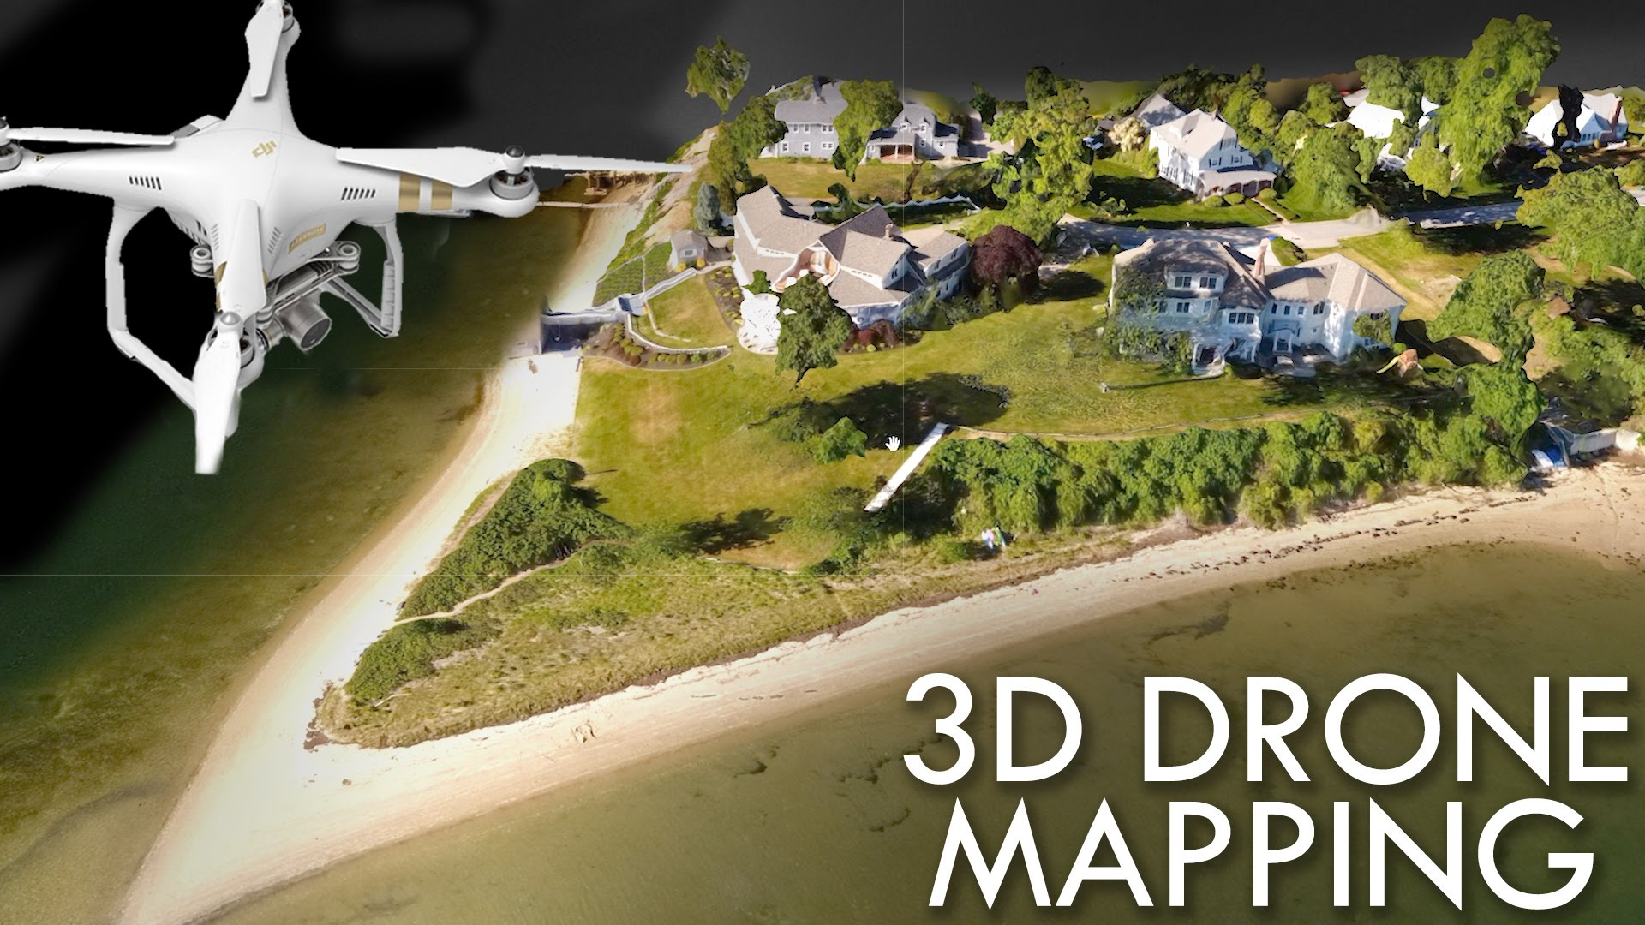


Drone Mapping
Digital Tactics
Your task:
Drones and other types of UAV as well as remotely piloted submarines fitted with high quality camera technology are becoming increasingly cheap to run and useful for performing detailed surveys and mapping of hard to reach places.
For example a client of ours is using high quality drone footage to create point cloud data and 3D models of and perform subsequent engineering surveys on rail track which is revolutionising this area of the industry (How/Why? Because typically to survey kilometres of rail track and embankments either side you need to close the railway for a period while a small team of expert engineers get a special inspection “cart” out onto the track and visually inspect the line; with a high quality drone footage the line is closed for a much shorter time or not at all, and a single skilled operative can generate data for engineers to inspect in office hours away from site – saving many man hours and costs relating to line closure).
Notes:
Wireframe shader

Slide 26
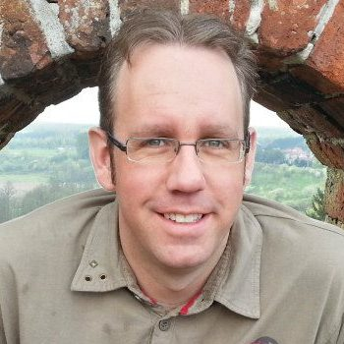
This
Task
Client…
Chris Dean
https://www.digitaltactics.co.uk/
Things They’d Like…
Aside from just visualising one 3D map in a desktop environment how could games tech be used to assist an engineer in reviewing this map and subsequent maps (and thereby observe change in the state of the map)?
Would VR allowing you to traverse the mapped area in a similar way to the traditional inspection be a good idea?
How can we illustrate change over time across maps in a meaningful way using overlays or transitions between maps?
What other information could games tech enable to derive from multiple versions of 3D maps over time or more generically 3D point clouds of real world places?
How could we use games tech to better interact with these real-world places remotely?
If additional data couple be added to such a map e.g. monitored data over time (moisture, stress, etc.) would this lead to something where games tech could be used to create a rich and useful visualisation of a place?
Notes:
Progress Log
Components, rationale
Tutor logging
Average percentage mark

Slide 27
Subtitles
World One Powerful Presentation Template
Notes:
Background placeholder: After choosing your image, Right click on the image -> Send to back -> Click on send to back

Slide 28
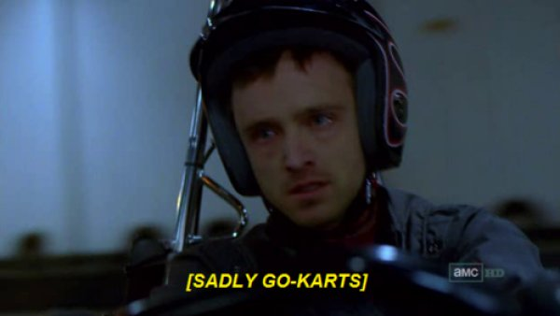
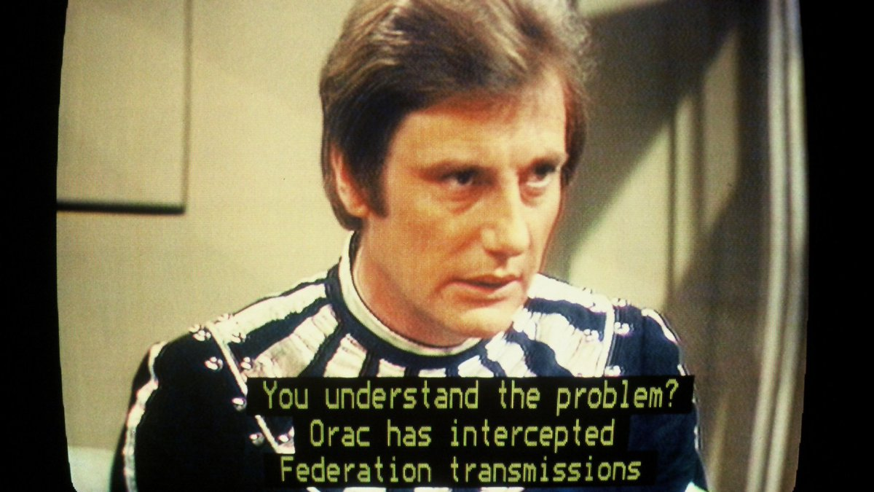
VR Subtitles
Sony Suggestion
Your task:
Implement a general system for PSVR subtitles
These need to be placed into the 3D world but potentially be customizable to different styles / standards
SONY Request!
Yep, I know for video most subtitles are not for disable folks, but what about in VR and games?
“Special Effect” might be someone to approach?
Notes:
Wireframe shader

Slide 29
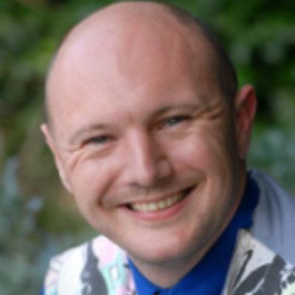
This
Task
Client…
Technically Sony but….
Dr Simon Scarle
Things They’d Like…
Must use the PSVR stuff and be a generic system(s)
Ideally should feed in through some for of “script”
Some of design / script editor tool
What expectations are there for subtitles in games?
How hard / easy would it be to compare/test these in VR?
Notes:
Progress Log
Components, rationale
Tutor logging
Average percentage mark

Slide 30
Clair
World One Powerful Presentation Template
Notes:
Background placeholder: After choosing your image, Right click on the image -> Send to back -> Click on send to back

Slide 31
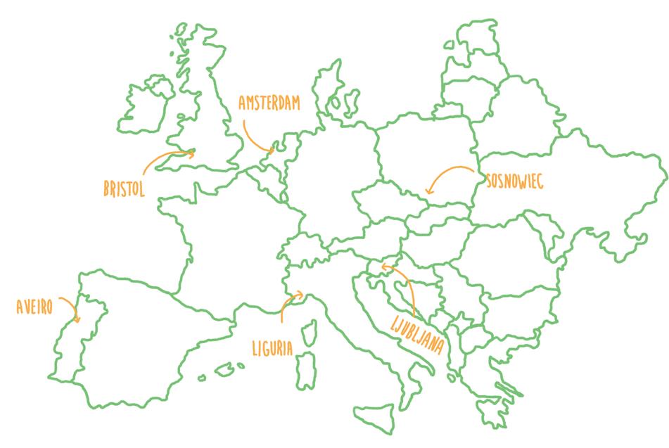
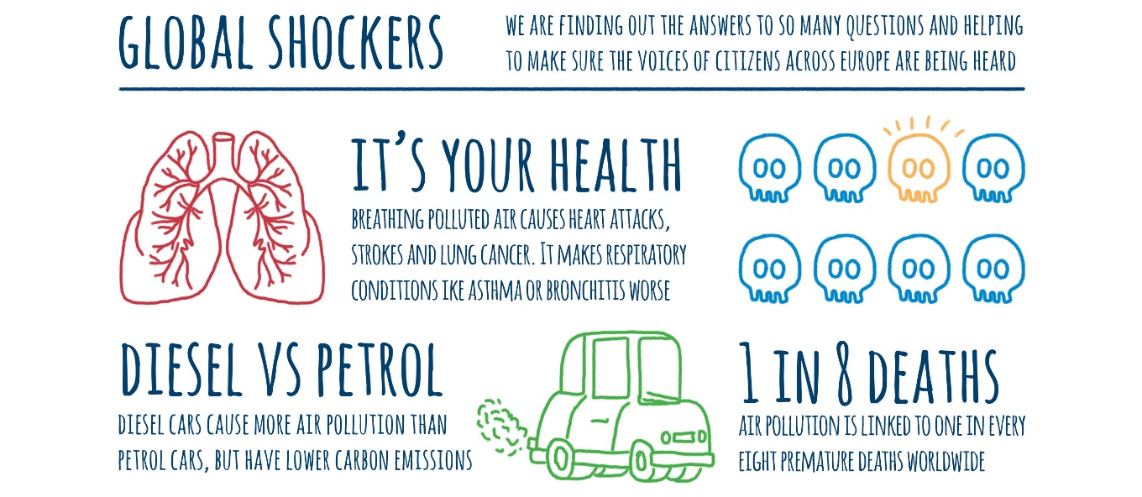

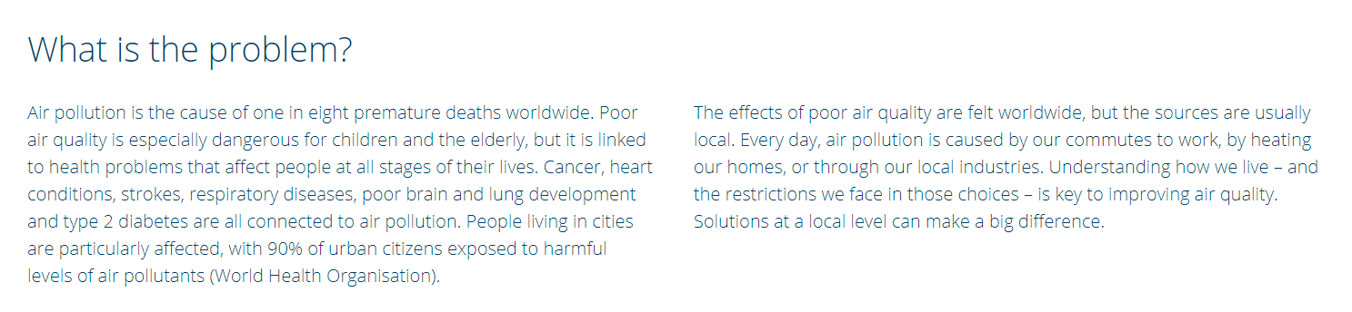
Clair City AR Data Visualisation
PlayWest Project
Notes:
Wireframe shader

Slide 32
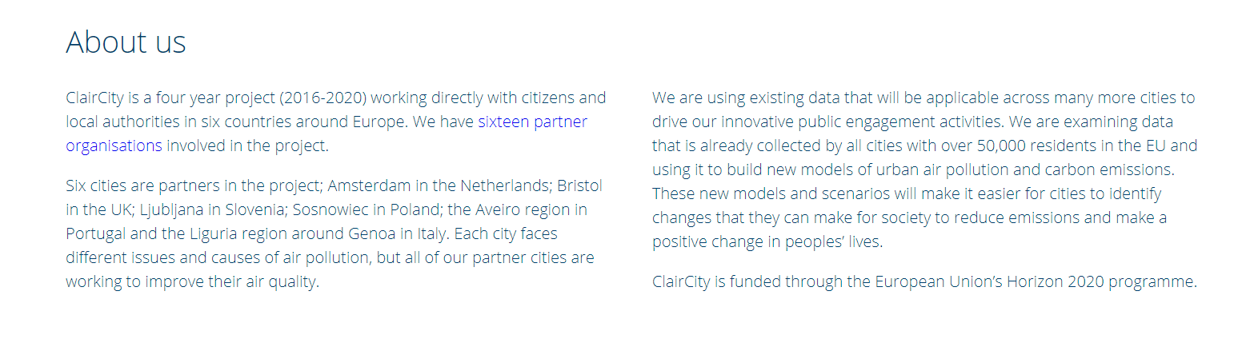
Clair City AR Data Visualisation
PlayWest Project
Notes:
Wireframe shader

Slide 33
This
Task
Client…
Ass. Prof Andy King
Alistair Mcallum
PlayWest
Things They’d Like…
Using a mobile “sim” game to collect data from the public and about their opinions about potential measures to improve air quality.
What visualisations are the academics used to?
What could be gained from moving to AR?
They do have the use of a Holo-lens!
Notes:
Progress Log
Components, rationale
Tutor logging
Average percentage mark

Slide 34
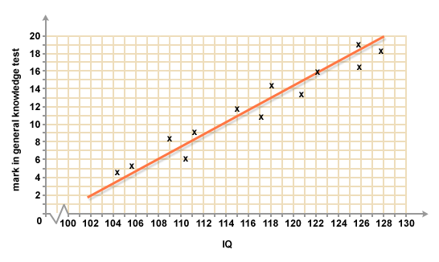
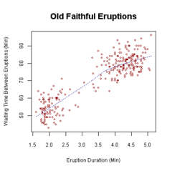
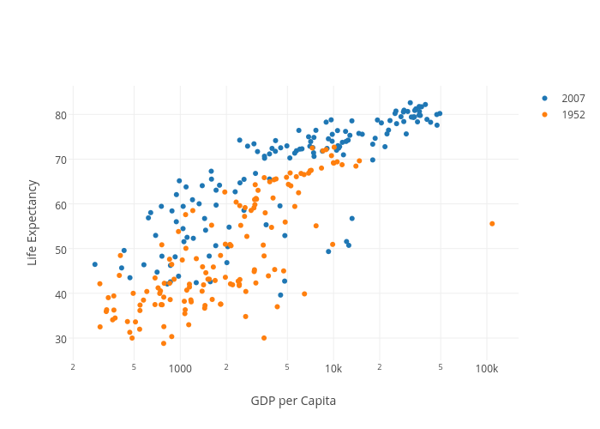
Less likely to get this amount of data but…
Quantitative over qualitative data
Classic experiment keeps everything else the same whilst varying a single aspect
Hence you can draw a graph
Often data is more “messy”
Say if humans are involved

Slide 35
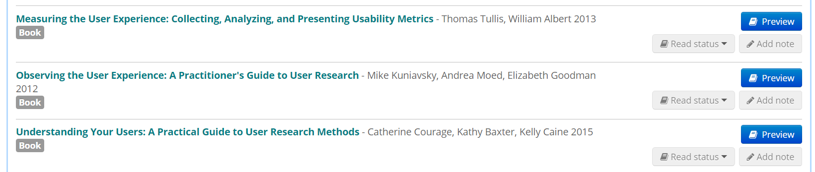
USEFUL
READING…
Resources on module reading list, see in particular the user research planning sections.

Slide 36
Ethics
Why?
http://www1.uwe.ac.uk/research/researchethics.aspx
http://www1.uwe.ac.uk/research/researchethics/frequentlyaskedquestions/studentresearchfaqs.aspx
World One Powerful Presentation Template
Notes:
Background placeholder: After choosing your image, Right click on the image -> Send to back -> Click on send to back

Slide 37
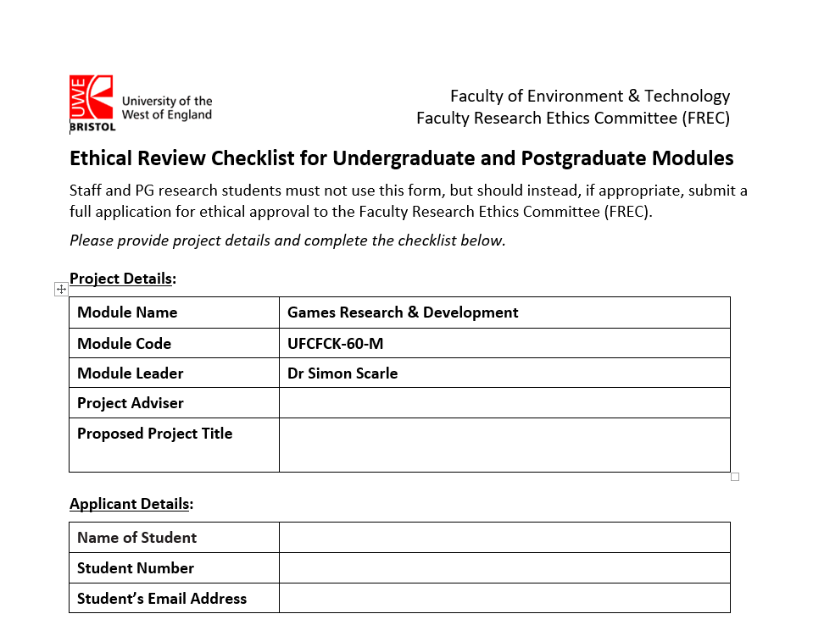

Slide 38
Any Questions?
You’ll get a lot more of this for your dissertation and you’ll have to much more apply it!
World One Powerful Presentation Template
Notes:
Background placeholder: After choosing your image, Right click on the image -> Send to back -> Click on send to back

Slide 39
Next Week:
I’ll set up the One Note
Assigned each of you your projects
Present your first thoughts of what you are going to do and how test it
World One Powerful Presentation Template
Notes:
Background placeholder: After choosing your image, Right click on the image -> Send to back -> Click on send to back

Slide 40
There After:
Until Christmas:
Mainly planning for the New Year but also preliminary implementation
Writing of a fuller proposal / research plan, test plan and setting of milestones with the clients
VIDEO + GROUP DISCUSSION
ONE – ON –ONE discussion with me
All documented in the One Note
World One Powerful Presentation Template
Notes:
Background placeholder: After choosing your image, Right click on the image -> Send to back -> Click on send to back

